Slide 1

Hard X-ray beamline design and optics consideration
Xianbo Shi
Optics Group, Advanced Photon Source

Slide 2
Outline
General design consideration
Design example: APS-U ISN beamline
Optics specification
Beamline Optics Design and Simulation Workshop 2025

Slide 3
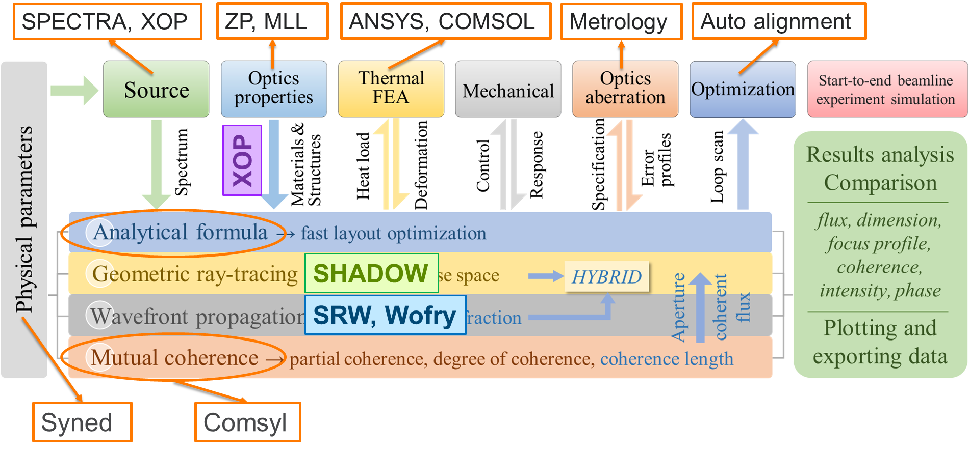
Integrated architecture framework for beamline optics design and simulation
Beamline Optics Design and Simulation Workshop 2025

Slide 4
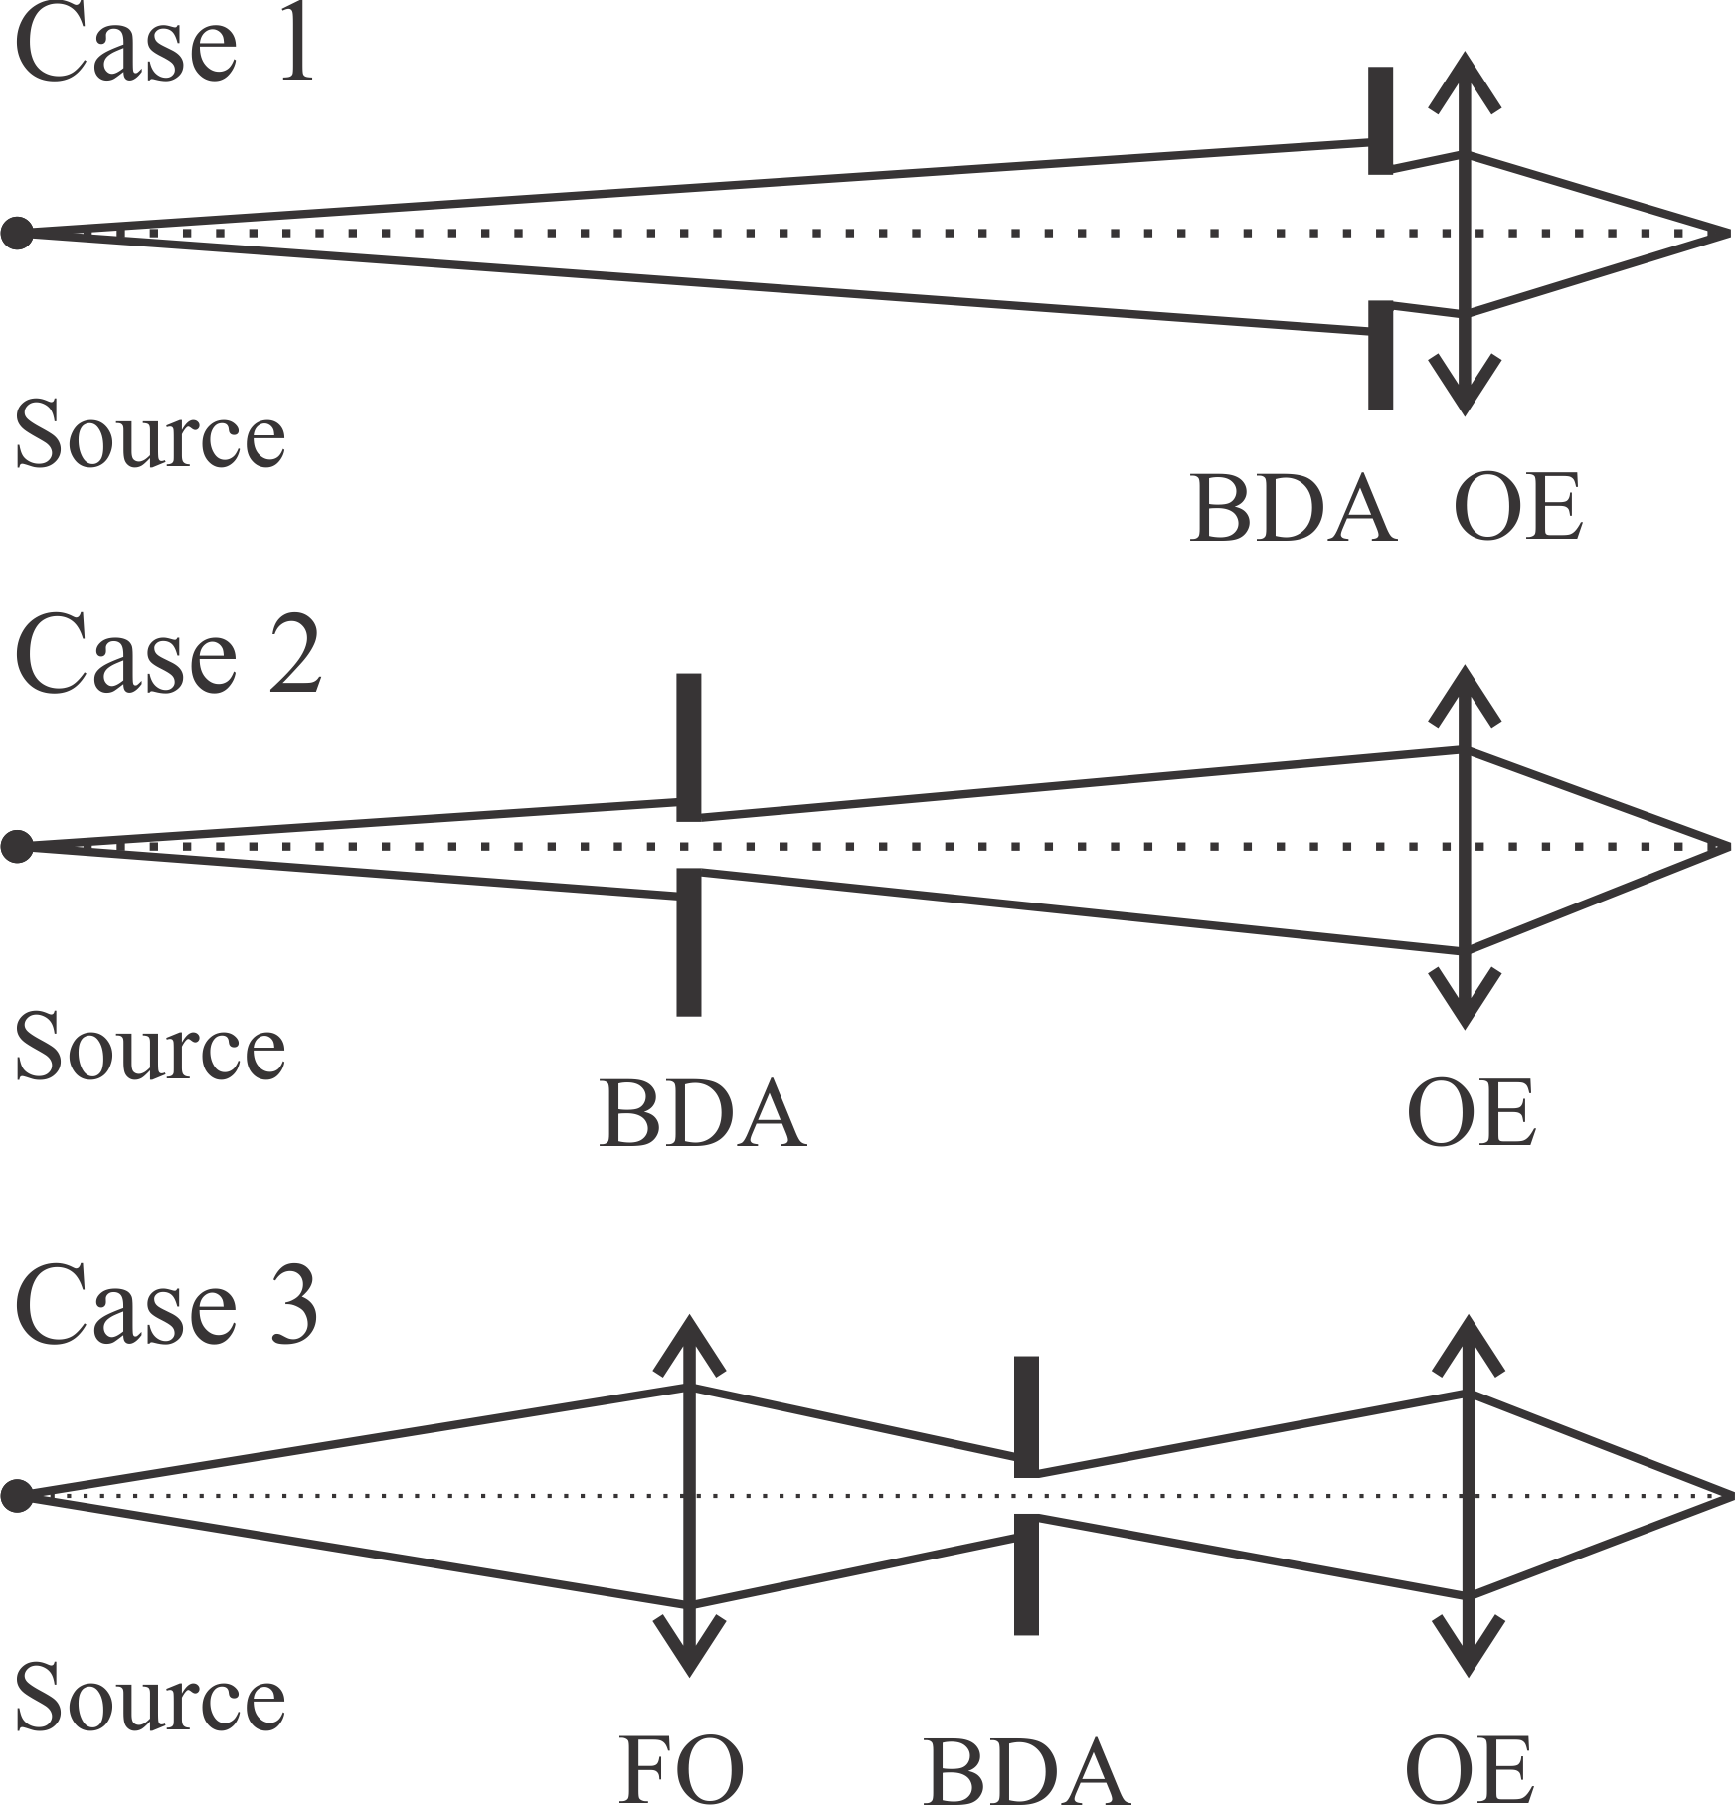
General beamline design considerations for APS-U
Focal size determined by the source demagnification and the BDA diffraction
Coherence controlled by BDA size
100s nm to micron focusing
Beamline Optics Design and Simulation Workshop 2025

Slide 5
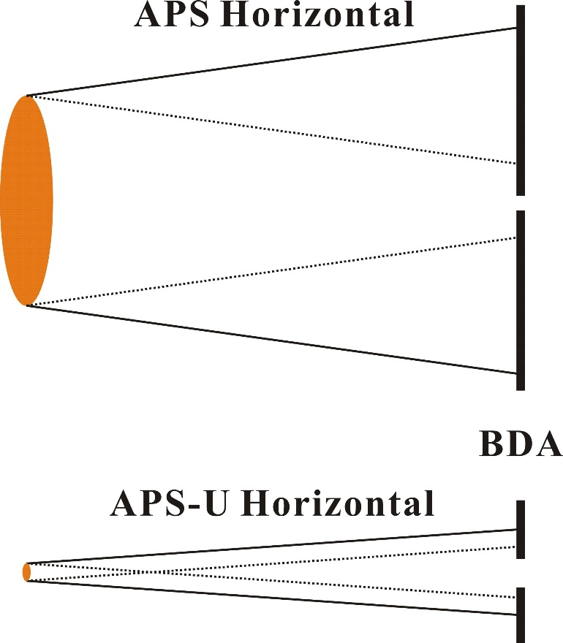
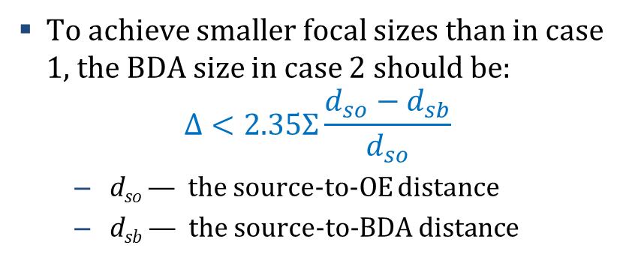
General beamline design considerations for APS-U
To achieve smaller focal sizes than in case 1, the BDA size in case 2 should be:
$$Δ<2.35Σ\frac{d_{so}−d_{sb}}{d_{so}}$$
d_{so} — the source-to-OE distance
d_{sb} — the source-to-BDA distance
E = 10 keV | APS | APS-U
Δ < (μm) | 413 | 23.5
Beam size at 25 m | 949 | 273
BDA transmission | 39% | 8%
L_{c, H} at 25 m (μm) | 2.3 | 40
Beamline Optics Design and Simulation Workshop 2025

Slide 6
General beamline design considerations for APS-U
Focal size determined by the source demagnification and the BDA diffraction
Coherence controlled by BDA size
100s nm to micron focusing
Not recommended for APS-U beamlines
BDA size defines the focal size and the coherence
For sub-100 nm focusing
Beamline Optics Design and Simulation Workshop 2025

Slide 7
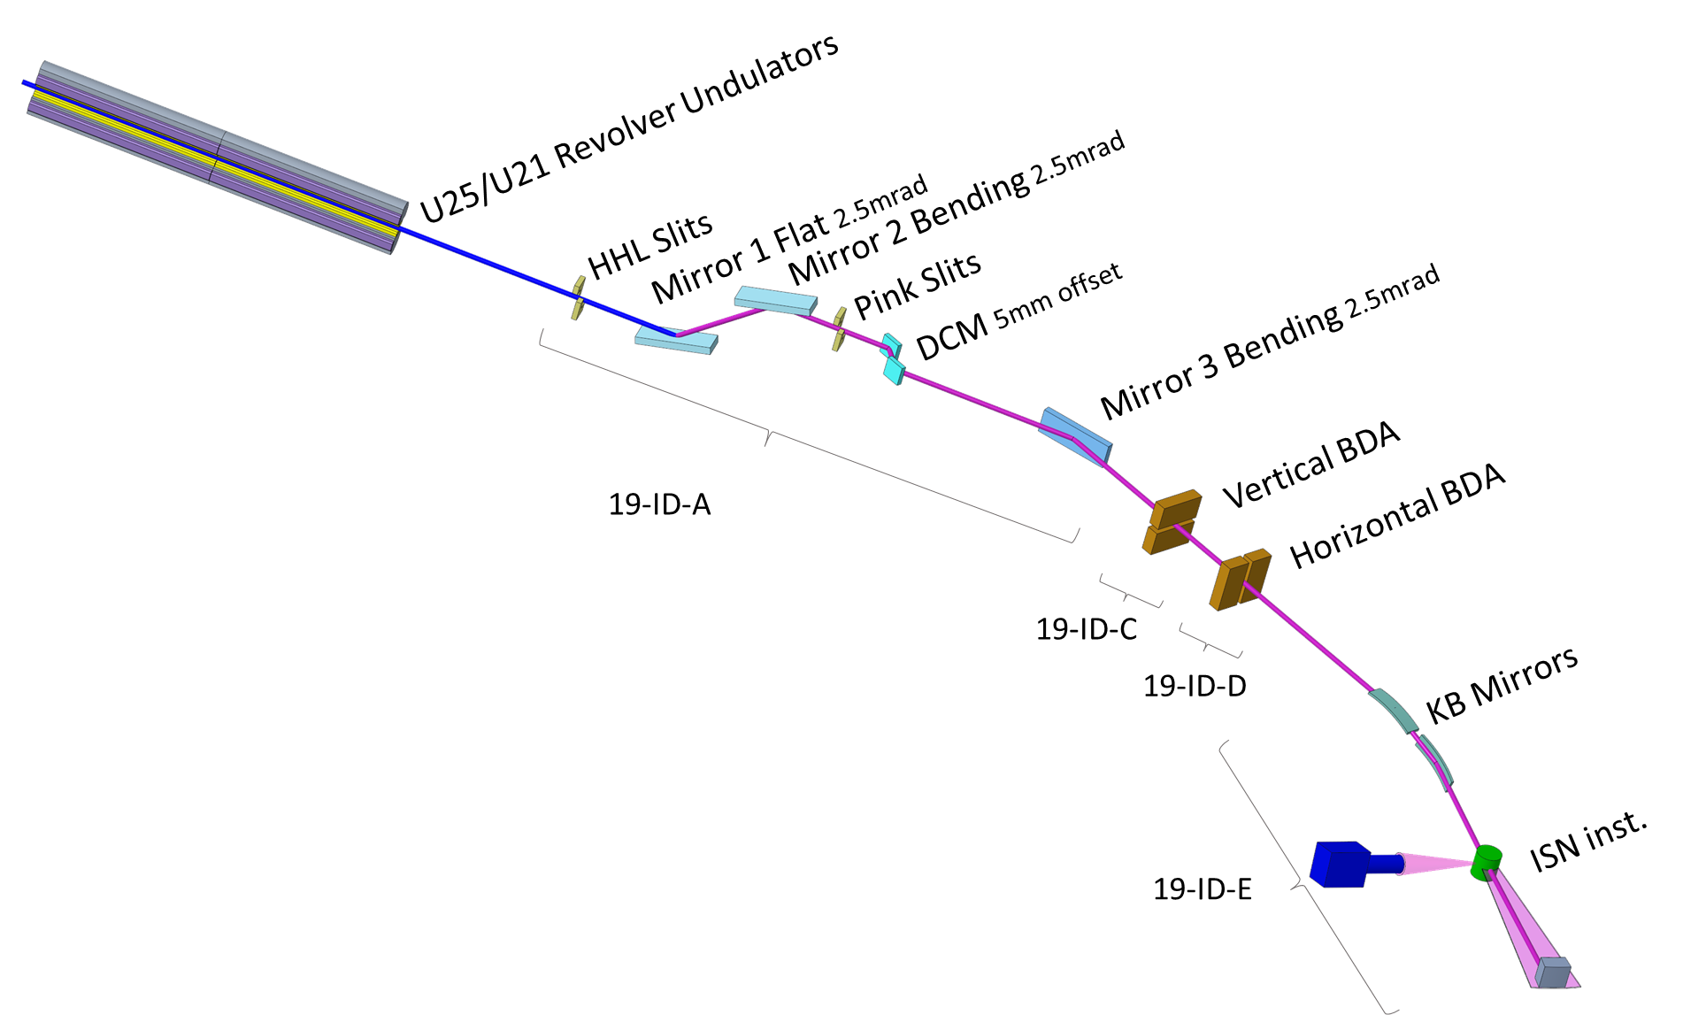
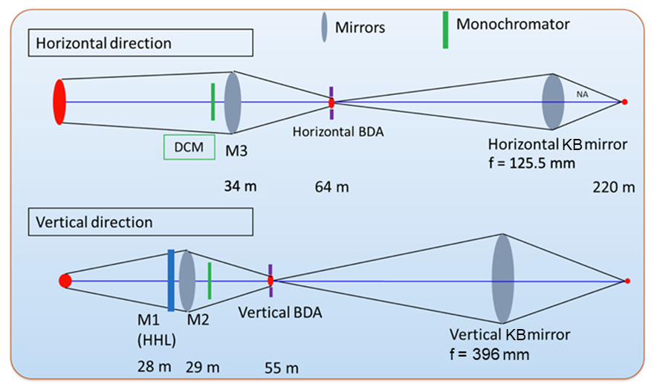
APS-U ISN beamline layout
Beamline Optics Design and Simulation Workshop 2025

Slide 8
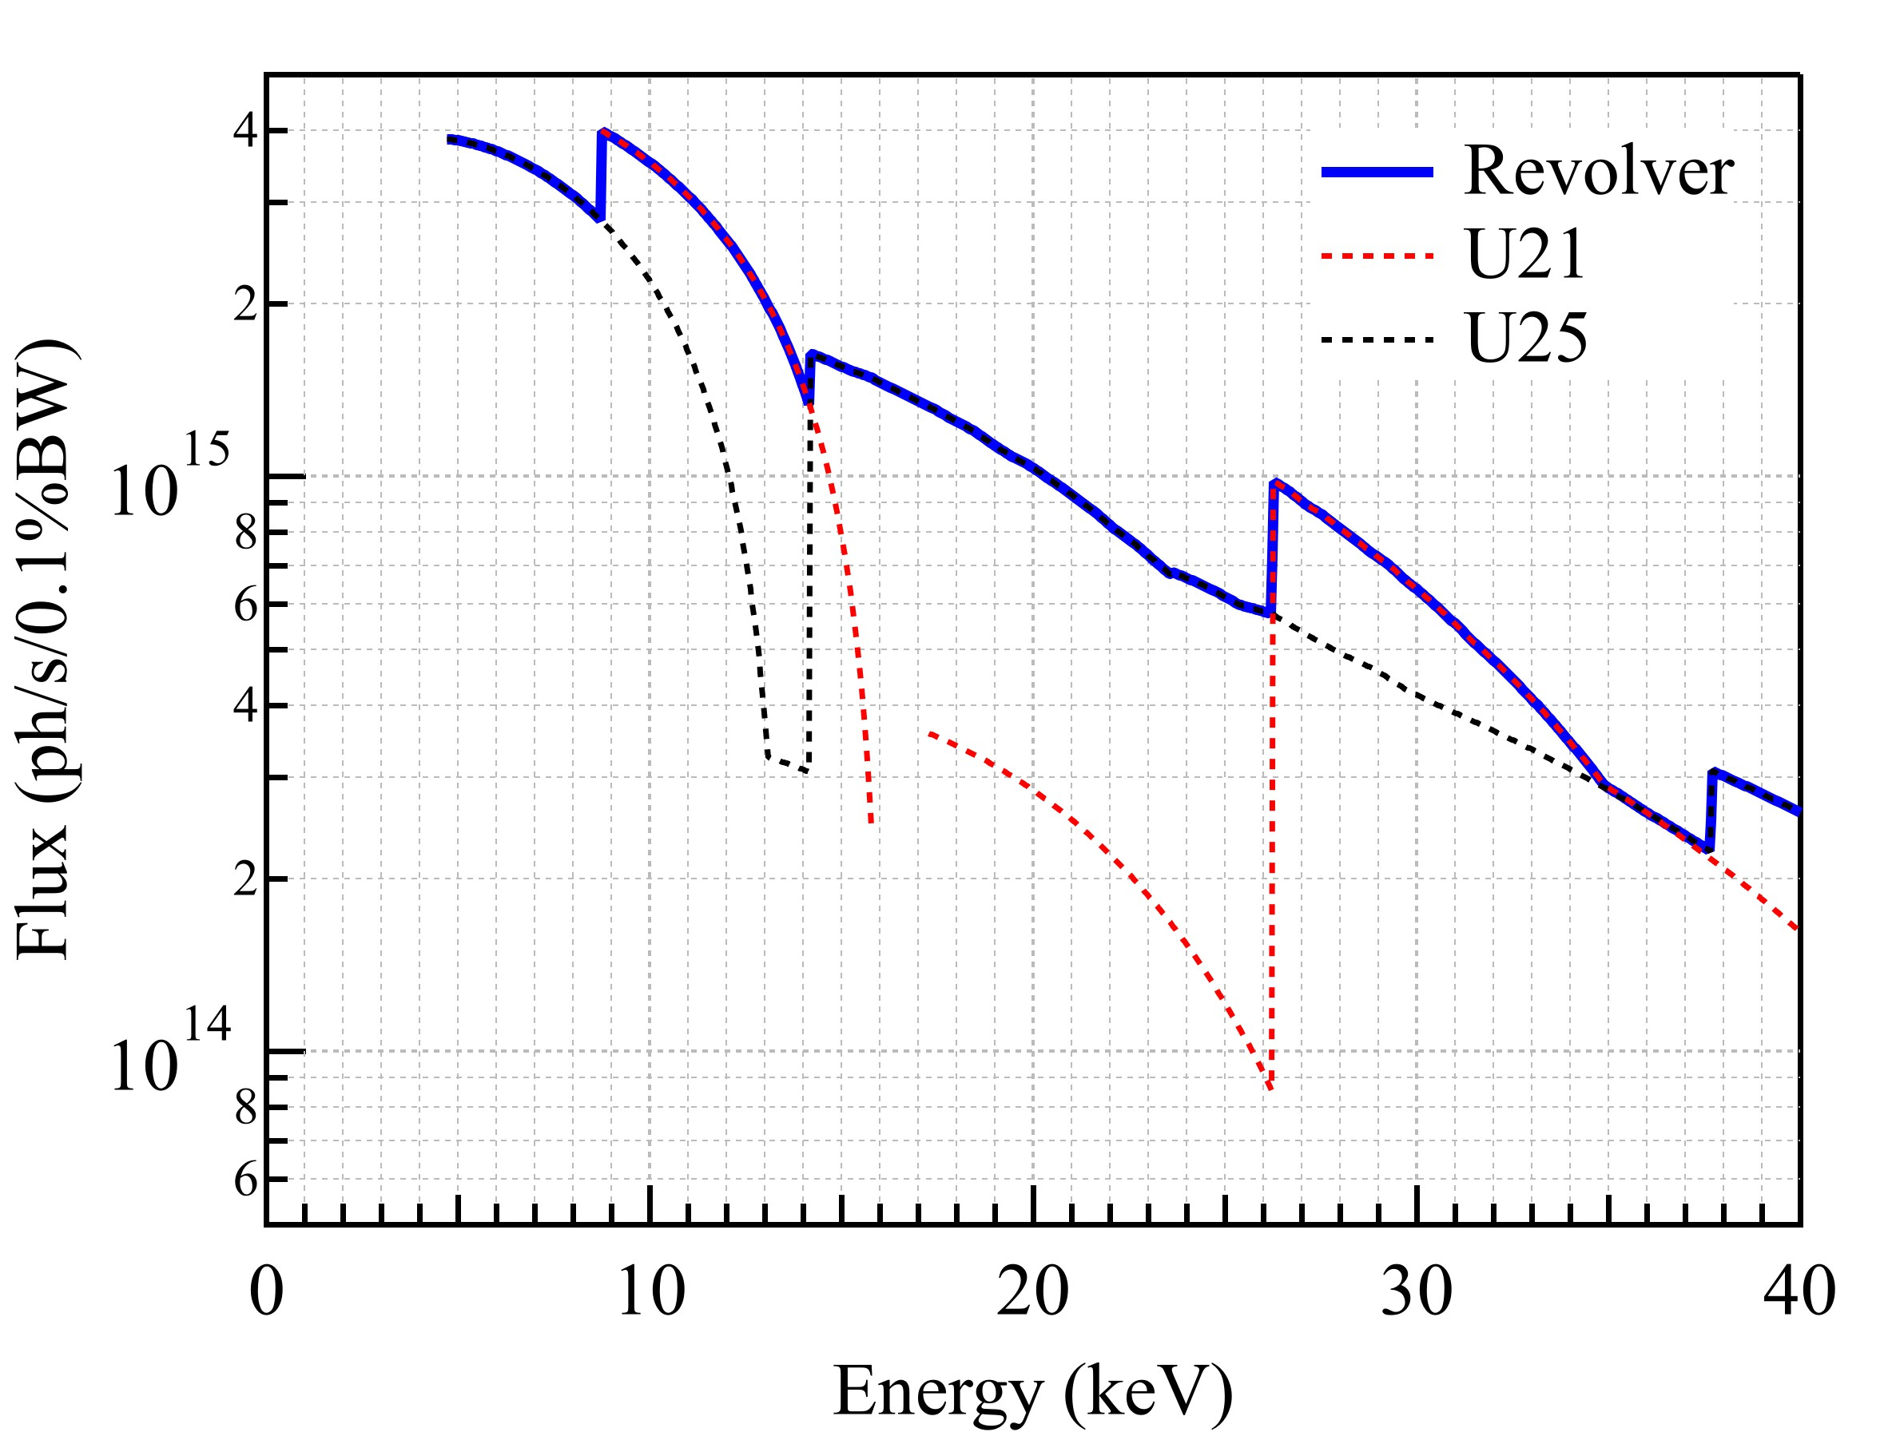
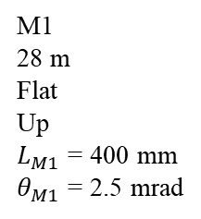
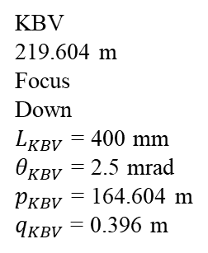
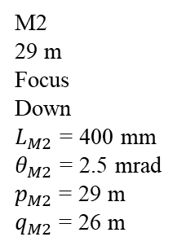
Analytical Calculation (Vertical Direction)
Focus at 220 m
Source
U25/U21 revolver
M2
29 m
Focus
Down
$L_{M2}$ = 400 mm
$θ_{M2}$ = 2.5 mrad
$p_{M2}$ = 29 m
$q_{M2}$ = 26 m
BDA V
55 m
Vertical
4 μm
KBV
219.604 m
Focus
Down
$L_{KBV}$ = 400 mm
$θ_{KBV}$ = 2.5 mrad
$p_{KBV}$ = 164.604 m
$q_{KBV}$ = 0.396 m
M1
28 m
Flat
Up
$L_{M1}$ = 400 mm
$θ_{M1}$ = 2.5 mrad
Beamline Optics Design and Simulation Workshop 2025

Slide 9
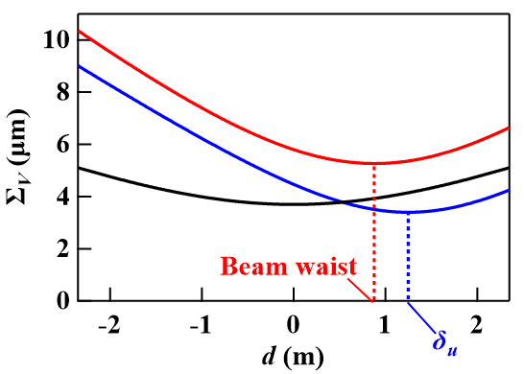
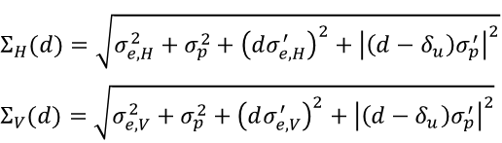
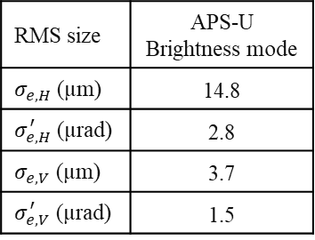
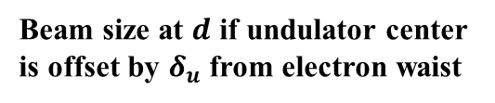
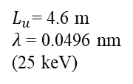
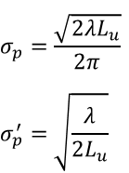
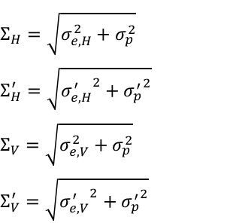
Analytical Calculation
Source
U25/U21 revolver
Electron beam
Photon beam
Total beam
Beam size at $d$ if undulator center is offset by $δ_{u}$ from electron waist
RMS size | APS-U Brightness mode
$σ_{e,H}$ (µm) | 14.8
$σ_{e,H}^{′}$ (µrad) | 2.8
$σ_{e,V}$ (µm) | 3.7
$σ_{e,V}^{′}$ (µrad) | 1.5
$$σ_{p}=\frac{\sqrt{2λL_{u}}}{2π}$$
$$σ_{p}^{′}=\sqrt{\frac{λ}{2L_{u}}}$$
$$Σ_{H}=\sqrt{σ_{e,H}^{2}+σ_{p}^{2}}$$
$$Σ_{H}^{′}=\sqrt{{σ_{e,H}^{′}}^{2}+{σ_{p}^{′}}^{2}}$$
$$Σ_{V}=\sqrt{σ_{e,V}^{2}+σ_{p}^{2}}$$
$$Σ_{V}^{′}=\sqrt{{σ_{e,V}^{′}}^{2}+{σ_{p}^{′}}^{2}}$$
$$Σ_{H}(d)=\sqrt{σ_{e,H}^{2}+σ_{p}^{2}+{\left(dσ_{e,H}^{′}\right)}^{2}+{\left|\left(d−δ_{u}\right)σ_{p}^{′}\right|}^{2}}$$
$$Σ_{V}(d)=\sqrt{σ_{e,V}^{2}+σ_{p}^{2}+{\left(dσ_{e,V}^{′}\right)}^{2}+{\left|\left(d−δ_{u}\right)σ_{p}^{′}\right|}^{2}}$$
$L_{u}$= 4.6 m
$λ$ = 0.0496 nm
(25 keV)
X. Shi, et al., Proc. SPIE 10388, 103880C (2017).
P. Elleaume, Undulators, Wigglers and Their Applications Ch. 3, 69–107, CRC Press (2002).
Beamline Optics Design and Simulation Workshop 2025

Slide 10
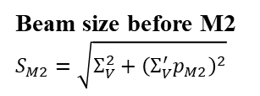
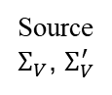
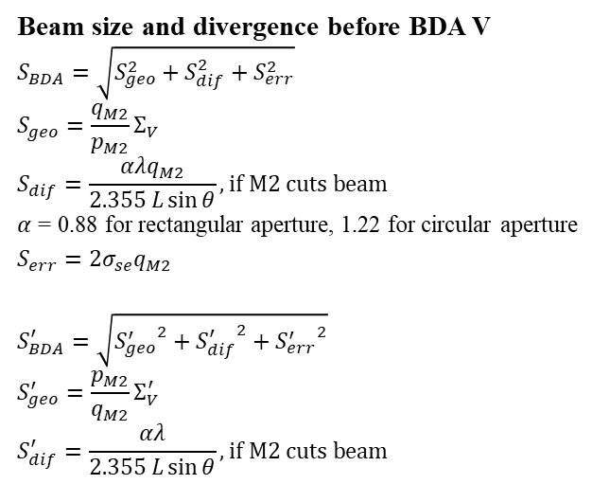
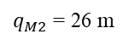
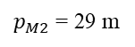
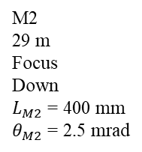
Analytical Calculation (Vertical Direction)
BDA V
55 m
$p_{M2}$ = 29 m
$q_{M2}$ = 26 m
Source
$Σ_{V}$, $Σ_{V}^{′}$
M2
29 m
Focus
Down
$L_{M2}$ = 400 mm
$θ_{M2}$ = 2.5 mrad
Beam size and divergence before BDA V
$$S_{BDA}=\sqrt{S_{geo}^{2}+S_{dif}^{2}+S_{err}^{2}}$$
$$S_{geo}=\frac{q_{M2}}{p_{M2}}Σ_{V}$$
$$S_{dif}=\frac{αλq_{M2}}{2.355 L\sin{θ}}, if M2 cuts beam$$
$α$ = 0.88 for rectangular aperture, 1.22 for circular aperture
$$S_{err}=2σ_{se}q_{M2}$$
$$S_{BDA}^{′}=\sqrt{{S_{geo}^{′}}^{2}+{S_{dif}^{′}}^{2}+{S_{err}^{′}}^{2}}$$
$$S_{geo}^{′}=\frac{p_{M2}}{q_{M2}}Σ_{V}^{′}$$
$$S_{dif}^{′}=\frac{αλ}{2.355 L\sin{θ}}, if M2 cuts beam$$
Beam size before M2
$$S_{M2}=\sqrt{Σ_{V}^{2}+{\left(Σ_{V}^{′}p_{M2}\right)}^{2}}$$
X. Shi, et al., Proc. SPIE 10388, 103880C (2017).
Beamline Optics Design and Simulation Workshop 2025

Slide 11
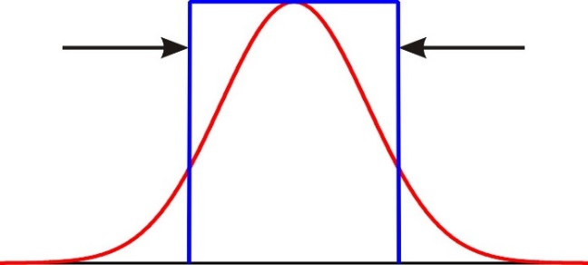
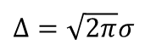
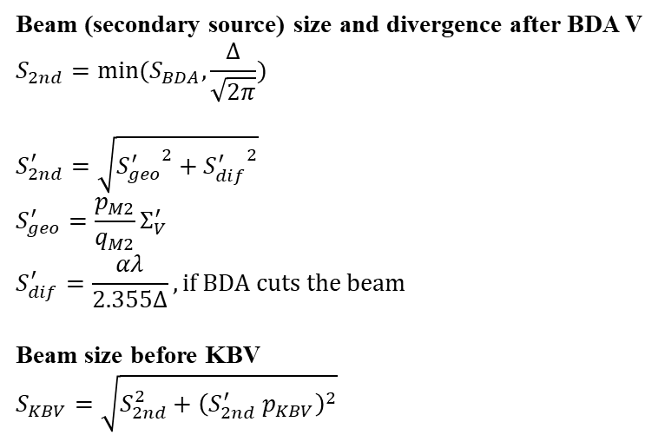
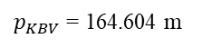
Analytical Calculation (Vertical Direction)
$p_{KBV}$ = 164.604 m
$p_{M2}$ = 29 m
$q_{M2}$ = 26 m
Source
$Σ_{V}$, $Σ_{V}^{′}$
M2
29 m
Focus
Down
$L_{M2}$ = 400 mm
$θ_{M2}$ = 2.5 mrad
BDA V size Δ
55 m
Beam (secondary source) size and divergence after BDA V
$$S_{2nd}=\min{(S_{BDA},\frac{Δ}{\sqrt{2π}})}$$
$$S_{2nd}^{′}=\sqrt{{S_{geo}^{′}}^{2}+{S_{dif}^{′}}^{2}}$$
$$S_{geo}^{′}=\frac{p_{M2}}{q_{M2}}Σ_{V}^{′}$$
$$S_{dif}^{′}=\frac{αλ}{2.355Δ}, if BDA cuts the beam$$
Beam size before KBV
$$S_{KBV}=\sqrt{S_{2nd}^{2}+{\left(S_{2nd}^{′} p_{KBV}\right)}^{2}}$$
$Δ=\sqrt{2π}σ$
X. Shi, et al., Proc. SPIE 10388, 103880C (2017).
Beamline Optics Design and Simulation Workshop 2025

Slide 12
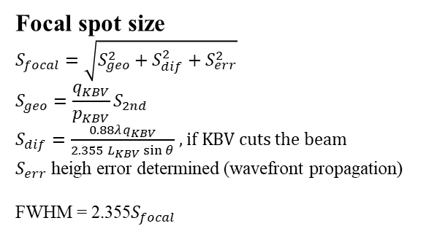
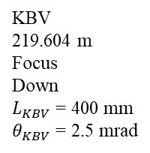
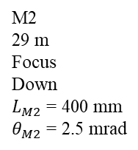
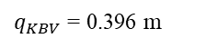
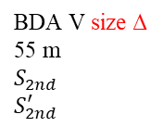
Analytical Calculation (Vertical Direction)
$p_{KBV}$ = 164.604 m
$q_{KBV}$ = 0.396 m
$p_{M2}$ = 29 m
$q_{M2}$ = 26 m
Source
$Σ_{V}$, $Σ_{V}^{′}$
M2
29 m
Focus
Down
$L_{M2}$ = 400 mm
$θ_{M2}$ = 2.5 mrad
BDA V size Δ
55 m
$$S_{2nd}$$
$$S_{2nd}^{′}$$
KBV
219.604 m
Focus
Down
$L_{KBV}$ = 400 mm
$θ_{KBV}$ = 2.5 mrad
Focal spot size
$$S_{focal}=\sqrt{S_{geo}^{2}+S_{dif}^{2}+S_{err}^{2}}$$
$$S_{geo}=\frac{q_{KBV}}{p_{KBV}}S_{2nd}$$
$S_{dif}=\frac{0.88λq_{KBV}}{2.355 L_{KBV}\sin{θ}}$ $, if KBV cuts the beam$
$S_{err}$ heigh error determined (wavefront propagation)
FWHM = 2.355$S_{focal}$
X. Shi, et al., Proc. SPIE 10388, 103880C (2017).
Beamline Optics Design and Simulation Workshop 2025

Slide 13
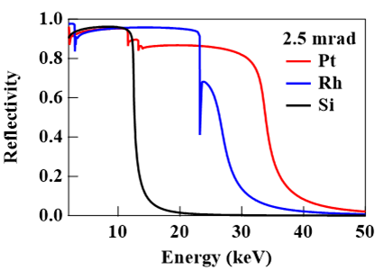
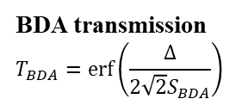
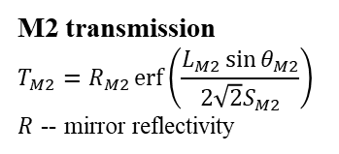
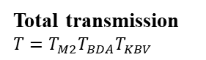
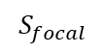
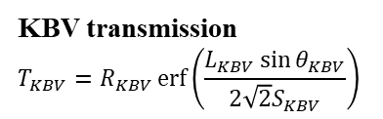
Analytical Calculation - Transmission
$p_{KBV}$ = 164.604 m
$q_{KBV}$ = 0.396 m
$p_{M2}$ = 29 m
$q_{M2}$ = 26 m
$$S_{focal}$$
Source
$Σ_{V}$, $Σ_{V}^{′}$
M2
29 m
Focus
Down
$L_{M2}$ = 400 mm
$θ_{M2}$ = 2.5 mrad
BDA V size Δ
55 m
$$S_{2nd}$$
$$S_{2nd}^{′}$$
KBV
219.604 m
Focus
Down
$L_{KBV}$ = 400 mm
$θ_{KBV}$ = 2.5 mrad
M2 transmission
$$T_{M2}=R_{M2}\operatorname{erf}\left(\frac{L_{M2}\sin{θ_{M2}}}{2\sqrt{2}S_{M2}}\right)$$
$R$ -- mirror reflectivity
BDA transmission
$$T_{BDA}=\operatorname{erf}\left(\frac{Δ}{2\sqrt{2}S_{BDA}}\right)$$
KBV transmission
$$T_{KBV}=R_{KBV}\operatorname{erf}\left(\frac{L_{KBV}\sin{θ_{KBV}}}{2\sqrt{2}S_{KBV}}\right)$$
Total transmission
$$T=T_{M2}T_{BDA}T_{KBV}$$
X. Shi, et al., Proc. SPIE 10388, 103880C (2017).
Beamline Optics Design and Simulation Workshop 2025

Slide 14
Analytical Calculation (EXCEL)
Beamline Optics Design and Simulation Workshop 2025

Slide 15
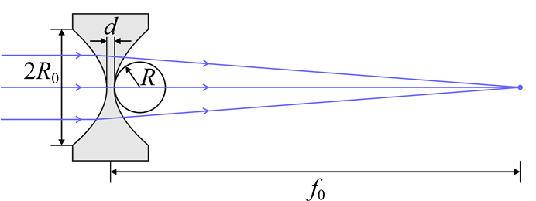
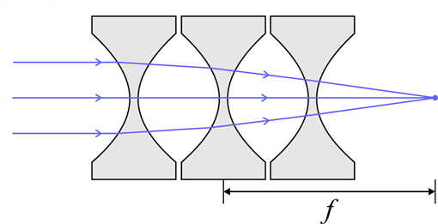
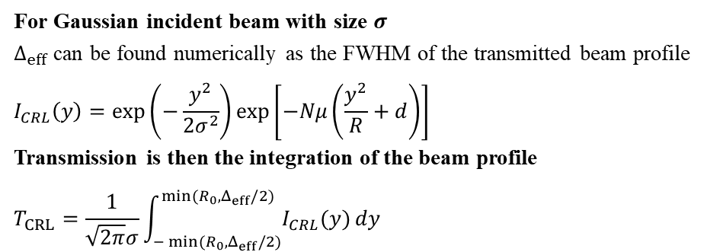
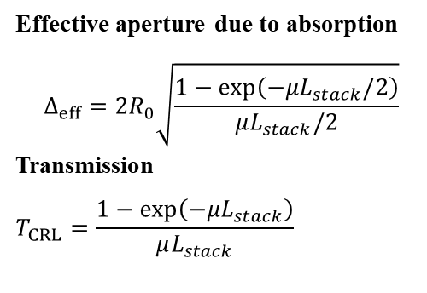
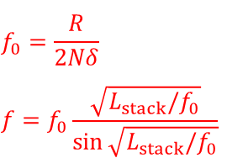
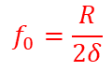
Analytical Calculation - CRL
Single lens
Compound refractive lenses (CRL)
$$f_{0}=\frac{R}{2δ}$$
$$f_{0}=\frac{R}{2Nδ}$$
$$f=f_{0}\frac{\sqrt{L_{stack}/f_{0}}}{\sin{\sqrt{L_{stack}/f_{0}}}}$$
Effective aperture due to absorption
$$Δ_{eff}=2R_{0}\sqrt{\frac{1−\exp\left(−μL_{stack}/2\right)}{μL_{stack}/2}}$$
Transmission
$$T_{CRL}=\frac{1−\exp\left(−μL_{stack}\right)}{μL_{stack}}$$
For Gaussian incident beam with size $σ$
$Δ_{eff}$ can be found numerically as the FWHM of the transmitted beam profile
$$I_{CRL}\left(y\right)=\exp\left(−\frac{y^{2}}{2σ^{2}}\right)\exp\left[−Nμ\left(\frac{y^{2}}{R}+d\right)\right]$$
Transmission is then the integration of the beam profile
$$T_{CRL}=\frac{1}{\sqrt{2π}σ}\int_{−\min{(R_{0},Δ_{eff}/2)}}^{\min{(R_{0},Δ_{eff}/2)}}{I_{CRL}(y)}dy$$
X. Shi, et al., Proc. SPIE 10388, 103880C (2017).
Beamline Optics Design and Simulation Workshop 2025

Slide 16
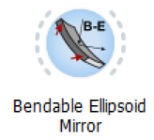
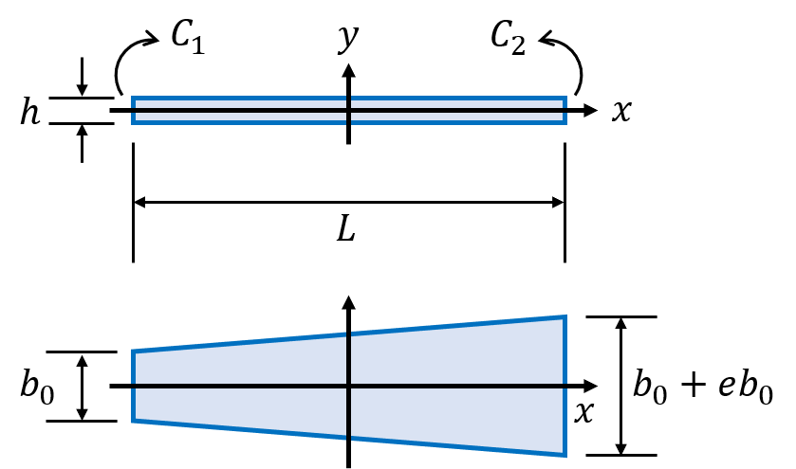
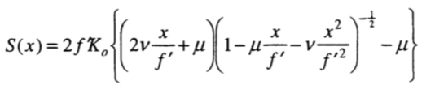
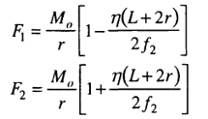
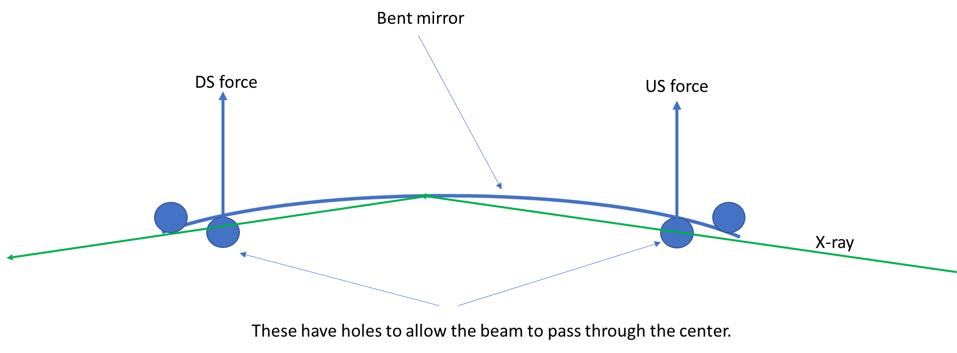
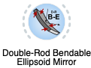



Analytical Calculation – Two moment bender mirror
$$y=H\left[\left(\frac{C+Dx}{D}\right)\ln\left(C+Dx\right)−x\right]−\frac{Bx^{2}}{2D}+Fx+G$$
$$A=\frac{C_{1}+C_{2}}{2}, B=\frac{C_{1}−C_{2}}{L}, C=\frac{Eh^{3}}{24}\left(2b_{0}+eb_{0}\right), D=\frac{Eh^{3}eb_{0}}{12L},H=\frac{AD+BC}{D^{2}}$$
$$G=−\frac{H}{2}\left[\left(\frac{C−DL/2}{D}\right)\ln\left(C−\frac{DL}{2}\right)+\left(\frac{C+DL/2}{D}\right)\ln\left(C+\frac{DL}{2}\right)\right]+\frac{BL^{2}}{8D}$$
$$F=\frac{H}{L}\left[\left(\frac{C−DL/2}{D}\right)\ln\left(C−\frac{DL}{2}\right)−\left(\frac{C+\frac{DL}{2}}{D}\right)\ln\left(C+\frac{DL}{2}\right)+L\right]$$
$E$ — Young’s modulus of elasticity
M. R. Howells, et al., Opt. Eng. 39, 2748 (2000).
L. Rebuffi, L. and X. Shi, Proc. SPIE 11493, 1149303 (2020).
Ideal slope
Bender slope
Bender Error$\left(x\right)=\int_{0}^{x}{S\left(x\right)−S_{M}\left(x\right)dx}$
Peter J. Eng, et al., Proc. SPIE 3449, 145-156 (1998).
Beamline Optics Design and Simulation Workshop 2025

Slide 17

OASYS SHADOWOUI
Beamline Optics Design and Simulation Workshop 2025

Slide 18


OASYS SHADOWOUI - Results
 | Analytical | Shadow
$Σ_{H}$ (μm) | 15.2 | 16.8
$Σ_{V}$ (μm) | 5.0 | 6.9
$Σ_{H}^{′}$ (μrad) | 3.6 | 3.7
$Σ_{V}^{′}$ (μrad) | 2.8 | 2.8
FWHM_{focal}, H (nm) | 20.5 | 16.7
FWHM_{focal}, V (nm) | 19.5 | 15.3
Total transmission | 1.04% | 0.78%
*Mirror reflectivity not considered.
Beamline Optics Design and Simulation Workshop 2025

Slide 19
Optics specification
Mechanical motion, stability, and misalignment
Optics aberration
Thermal consideration
Beamline Optics Design and Simulation Workshop 2025

Slide 20





Mechanical motion, stability, and misalignment
Y
Yaw
Beam
$p_{M1}$ = 28 m
Z
Source
$Σ_{H}$, $Σ_{H}^{′}$
$Σ_{V}$, $Σ_{V}^{′}$
Roll
M1
Pitch
X
Pitch angle resolution
$$δ_{Pitch}=\frac{2.355aΣ_{V}}{2p_{M1}}$$
$a$ = 0.1 means the pitch resolution moves the virtual source by 10% of the vertical source size (FWHM).
Pitch vibration
$$Σ_{eff}=\sqrt{Σ_{V}^{2}+{N_{optics}\left({2σ}_{vib}p_{M1}\right)}^{2}}$$
$$Σ_{eff}<(1+a)Σ_{V}$$
$$σ_{vib}<\frac{\sqrt{a^{2}+2a}}{2\sqrt{N_{optics}}}\frac{Σ_{V}}{p_{M1}}$$
For $a$ = 0.1, $N_{optics}$ = 2 (M1, M2 before BDA)
$$σ_{vib}<0.162\frac{Σ_{V}}{p_{M1}}$$
Roll angle resolution
$$δ_{Roll}=\frac{2.355aΣ_{H}}{2p_{M1}\sin{θ_{M1}}}$$
$a$ = 0.1 means the roll resolution moves the virtual source by 10% of the horizontal source size (FWHM).
Beamline Optics Design and Simulation Workshop 2025

Slide 21










Mechanical motion, stability, and misalignment
Monochromator relative pitch vibration
Focusing mirror angular vibration
$$Σ_{eff}=\sqrt{Σ^{2}+{N_{optics}\left(2σ_{vib}d_{SM}\right)}^{2}}$$
$Σ_{eff}<\left(1+a\right)Σ$, e.g., $a=0.1$
$$d_{SM}$$
$$S_{foc}=\sqrt{S_{ideal}^{2}+{N_{optics}\left(2σ_{vib}q\right)}^{2}}$$
$S_{foc}<(1+a) S_{ideal}$, e.g., $a=0.1$
Focusing lens positional vibration
$$p$$
$$q$$
BDA serves as the new source and isolates the source, FM, and Mono vibration.
$$S_{foc}=\sqrt{S_{ideal}^{2}+N_{optics}{[σ_{vib}(1+q/p)]}^{2}}$$
$$S_{foc}<(1+a) S_{ideal}\text{, }\text{e}\text{.}\text{g}\text{., }a=0.1$$
Beamline Optics Design and Simulation Workshop 2025

Slide 22





Mechanical motion, stability, and misalignment
Y
$q_{v}$ = 396
Yaw
$q_{h}$ =125.5
Beam
Z
Roll
KBV
Pitch
X
KBH
$L_{v}$ = 400
$L_{h}$ =125
KBV pitch angle misalignment using OASYS-ShadowOui
Beamline Optics Design and Simulation Workshop 2025

Slide 23



Optics Aberration – Mirror Figure Error
Beamline Optics Design and Simulation Workshop 2025

Slide 24






Optics Aberration – Mirror Figure Error
Beamline Optics Design and Simulation Workshop 2025

Slide 25


Optics Aberration – Mirror Figure Error
Beamline Optics Design and Simulation Workshop 2025

Slide 26





Optics Aberration – CRL Thickness Error
Beamline Optics Design and Simulation Workshop 2025

Slide 27


Thermal consideration
M2 absorbed power
XOPPY ShadowOui loop
SRCalc
FEA
ANSYS
COMSOL
No thermal bump
With thermal bump
Bending corrected
Ray-tracing
Beamline Optics Design and Simulation Workshop 2025

